Slide 1
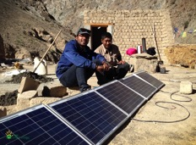
IEEE Smart Village and Human Rights

Slide 2
IEEE Smart Village
And Human Rights
Panel Session
IEEE Smart Village Workshop

Slide 3
Panelists
Panel Leader - Robin Podmore
Panelist: Musa Dan Fodio – Attorney
Panelist: Dan Wessner – Regis University

Slide 4
Development as Freedom
Amartya Sen, winner of the 1998 Nobel Prize in Economics, argues that economic development entails a set of linked freedoms: political freedoms, transparency in relations, access to credit and escape from abject poverty through creation of jobs.
More pragmatically; Paul Polak author of “Out of Poverty” argues that the best way to help people living on $1 to $2 per day is to show them how to earn more money.

Slide 5
Question 1
Please summarize your unique and extensive career work on human rights.

Slide 6
Question 2
How can IEEE Smart Village support the European Refugee Crisis with electrification, education and job creation in camps?

Slide 7
Question 3
What funding is available to support growth of IEEE Smart Village in this area?

Slide 8
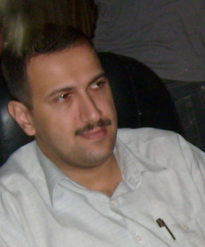
Mohammed Al-Nuaimi
Colleague of Robin Podmore and Chris Mosier.
We worked on a building a model of the Iraq power system to train Iraq power system operators in Baghdad Green Zone in 2008 and 2009.
Under subcontract to RTI
Worked for Iraq Ministry of Electricity
Now in refugee camp in Turkey with son.

Slide 9
Mohammed Al-Nuaimi
Please let me know if I can help with your group, now that I am one of them, I know how much they appreciate the simplest actions, like a pray or an email.
I have nothing to do here because we are not allowed to have jobs here.
I have implemented lot of control and automation systems using PIC micro-controllers, Raspberry PI and ASP.net web applications via C#.
So, I would really appreciate it if you find me a way that I can help with your group's projects because otherwise my brain is shutting down.

Slide 10
Mohammed Al-Nuaimi
It is easy for me to design a controller to do all what is in the presentation; I just need more details.
I may also easily embed the WIFI and GPS modules, which I think they are very important for you as long as you want to remotely shut down the device. My idea is that the device gets an expiry date when it is connected to the internet and it keeps running as long as it is getting an earlier date that the expiry date from the GPS module. The device will also has a built in memory to log everything you want like location and usage every configurable period, then when it is connected to the internet, this data will be sent to the server and when it is done, the server will send the activation code. By this we will assure that all the logged data are delivered.
By doing this, you will assure that the device will automatically shut down even if it is not connected to the internet, and you will get all the data you want before re-activating the device.

Slide 11
Mohammed Al-Nuaimi
Everything will be done using PIC micro-controllers. I usually use Proton picbasic to program, I will surly hand the source codes over to you.
Mainly, all the sources will be combined into one 10.5 to 60 volt. Al circuits are to be fed from this source.
One circuit to monitor the charging, it will limit the charging current using PWM to extend the life of the battery and the charging equipment; By this, we control the output current so no matter how dead is the battery, we will not overload the circuit nor ruin the battery.
The output circuit will monitor the voltage range, disconnects the output if it is less than the low voltage limit or higher than the high voltage limit; It will also monitor the power consumed, if it exceeds the 75W limit, you can choose from immediately disconnecting the load, or to have a delay depending on the deviation from the 75W limit. By this, we will not need the thermal and short circuit protection.
You may send me circuit boards to my address: Mohammed Alnuaimi Yucetepe Sk No:34/2, Hastanebasi Mahallesi, 55040 İlkadım/Samsun, Turkey

