Slide 1
Sponsored by IEEE Smart Village Through Kilowatts for Humanity
LICHI's Community Solutions ltd
Reaching out and working with communities
Plot No. 12159, Chingola Central, Chingola Zambia
Presenter Likonge Makai Mulenga
Director LCS Ltd
Employee at Konkola Copper Mines Plc as Assistant Engineering Superintendant – Concentrator /Energy Management

Slide 2
Content
Meeting Dr Robin Podmore at IEEE GHTC – 2013
Project survey and formation of NG0 in 2014
Project evaluation, implementation and commissioning 2015
Filibaba Kiosk Energy Station
Future plans

Slide 3
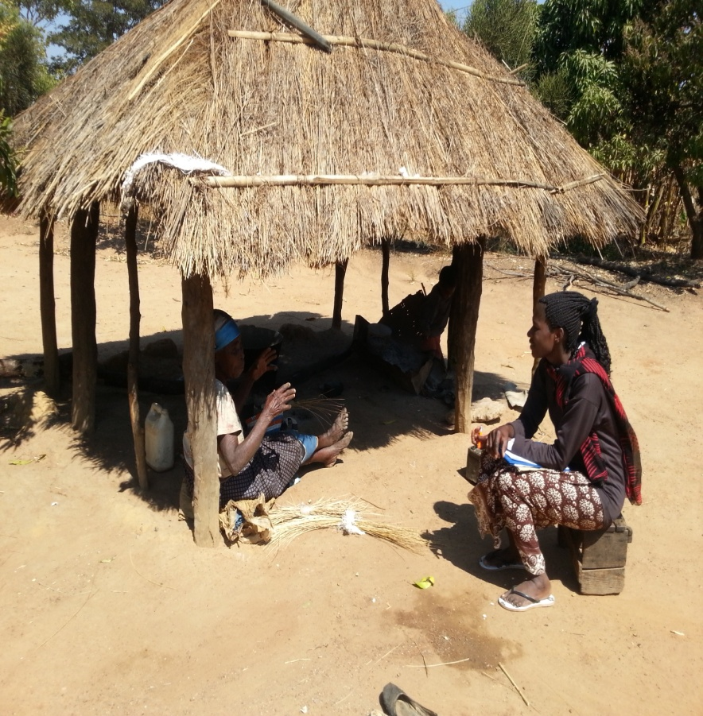
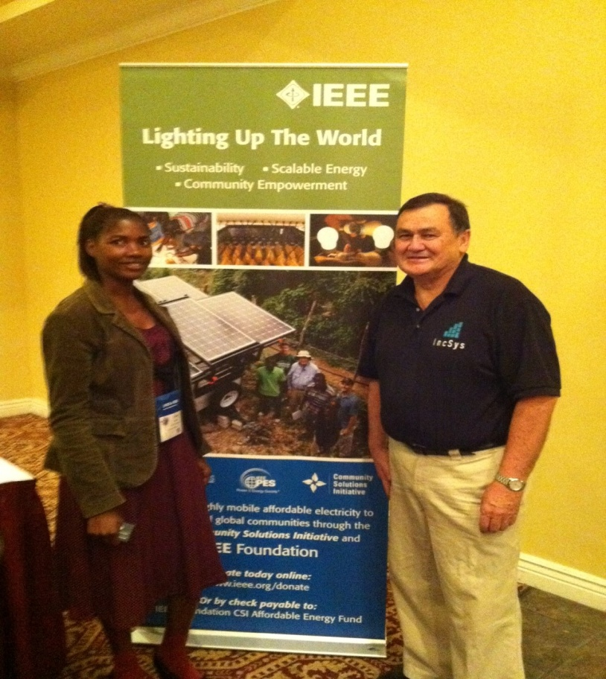
Meeting Dr Podmore
Wrote paper on cooking techniques in Zambia – Biogas
Presenting paper at IEEE GHTC – 2013 at San Jose, CA

Slide 4
Project Evaluation, Implementation and Commissioning
August 2014 Steve and Henry visited for survey evaluation
March 2015 Steve , Matt and Emily came for location and contractor evaluation
September 2015, team of 11 Kilowatts for Humanity came for kiosk installation supervision, educating and commissioning

Slide 5
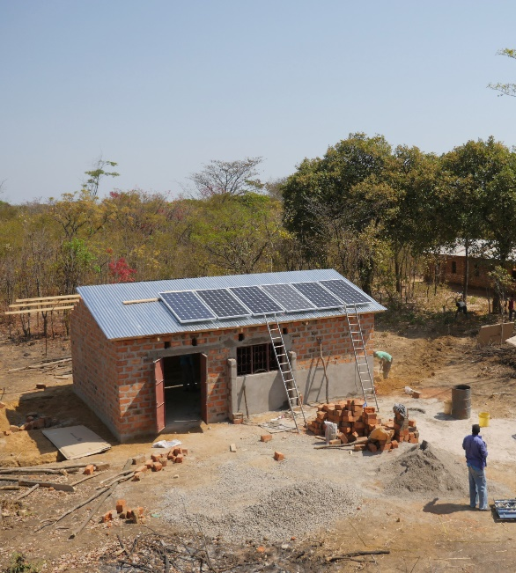
Project implementation: Schematics
Community church
Community church
Energy
Kiosk
Metered circuit
Lighting and music for services and events
Metered circuit
Not connected; no agreement with church leaders
PBK rentals
PBK charging
Phone charging
Solar home kit sales
‘Talk time’ sales
Solar panel installation at kiosk
(View from the northeast)
Land owned by LiChi NGO
Wired system with data logger

Slide 6
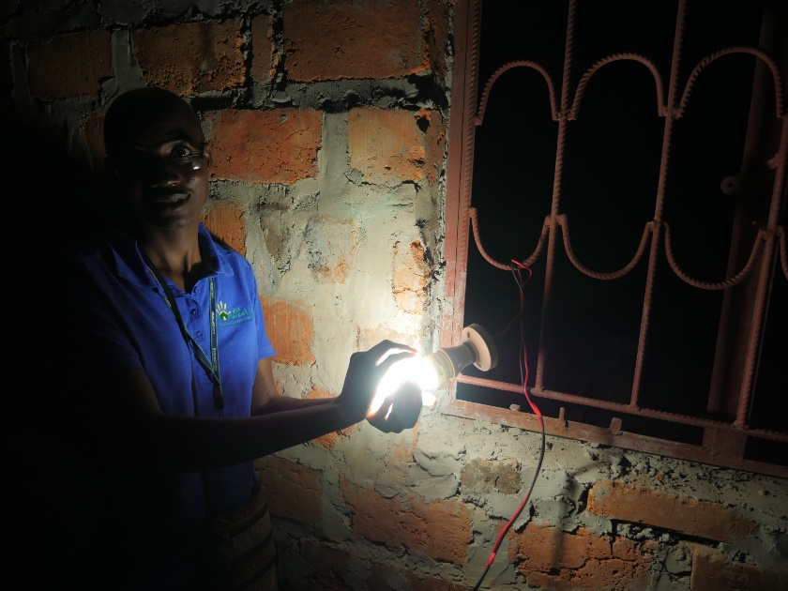
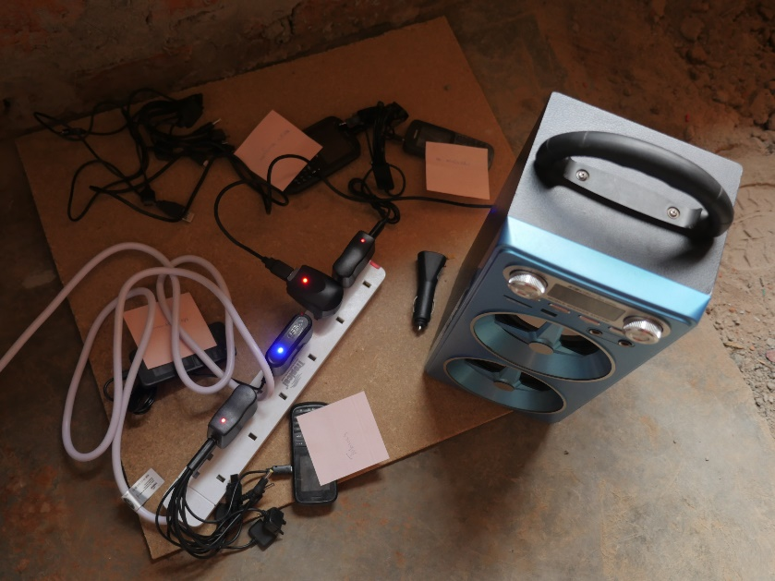
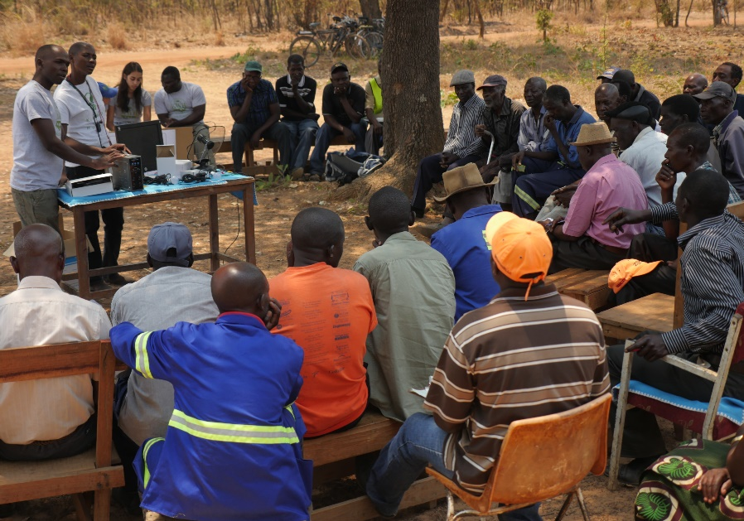
Project implementation: First customers
Community meeting led by LiChi NGO and new kiosk manager
Immediate interest and first customers
First light provided by kiosk
First phones and radio being charged
Community meeting and training

Slide 7
Filibaba Kiosk Energy Station
Employees
Kiosk Manager
Watchman
Activities
Phone charging
Distributed 29 solar lighting home kits and 1 donated to community school
Airtime selling – trial and proved income generating

Slide 8
Daily activities
On average 6 phones are brought to be charged per day; maximum so far been 7 phones
Commencement date 18 Sep 2015
On average K44 worth talk time is sold per day: maximum so far K79
Commencement date 27 Sep 2015

Slide 9
Project impact and lessons learned
Energy kiosk is now operational
Starting point for electricity-based businesses in Filibaba
Future expansion of the business may be necessary to meet costs
ie, Sales of cold drinks; electrify nearby homes;
Sufficient power capacity and potential to expand the solar system
Lessons learned:
Flexibility in design is critical
Time constraints must be mapped out early
High variance in survey responses (particularly with regard to willingness to pay)

Slide 10
Future Plans
Provide portable battery kits that an power TV, radio, fan, etc
Selling accessories as above and others
Selling sodas and groceries
Selling airtime, provide internet, printing and photocopying
Chicken layering
Become renewable energy consultant

Slide 11
Acknowledgements
This project was funded by IEEE Smart Village through Kilowatts for Humanity

